Slide 1
Sports and statistics Lecture 6: NFL, expected points, game theory

Slide 2
Goals
Expected points
NFL game theory & decision making
Tools
Expected value
Review of logistic regression

Slide 3
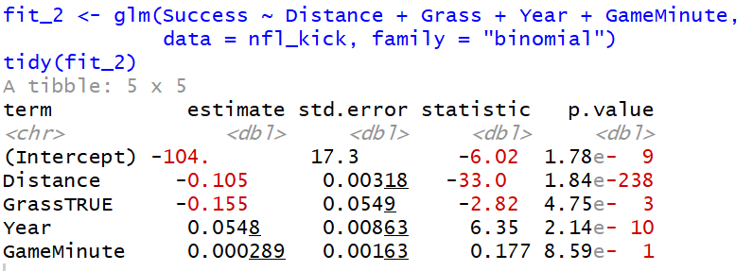
From last week:
Summary: odds ratios, z-test statistics, predicted probabilities

Slide 4
Link to expected points:
Transform logistic regression model into probabilities
predict() function (or by hand)
Example:
P(Success = 1 | Dist = 40, Grass = TRUE, Yr= 2010, GM = 10) = 0.82
Expected points: E(X_{i}) = x_{i}*p_{i}
3*0.82 = 2.46 points
Interpretation:

Slide 5
Link to expected points:
So kicking a field goal attempt is worth 2.46 points. What else?
Other possible decisions:
-Go for it
-Punt it?
All possible outcomes:
-Successful fourth down conversion
-Successful field goal
-Missed fourth down conversion
-Missed field goal
-Disaster plays

Slide 6
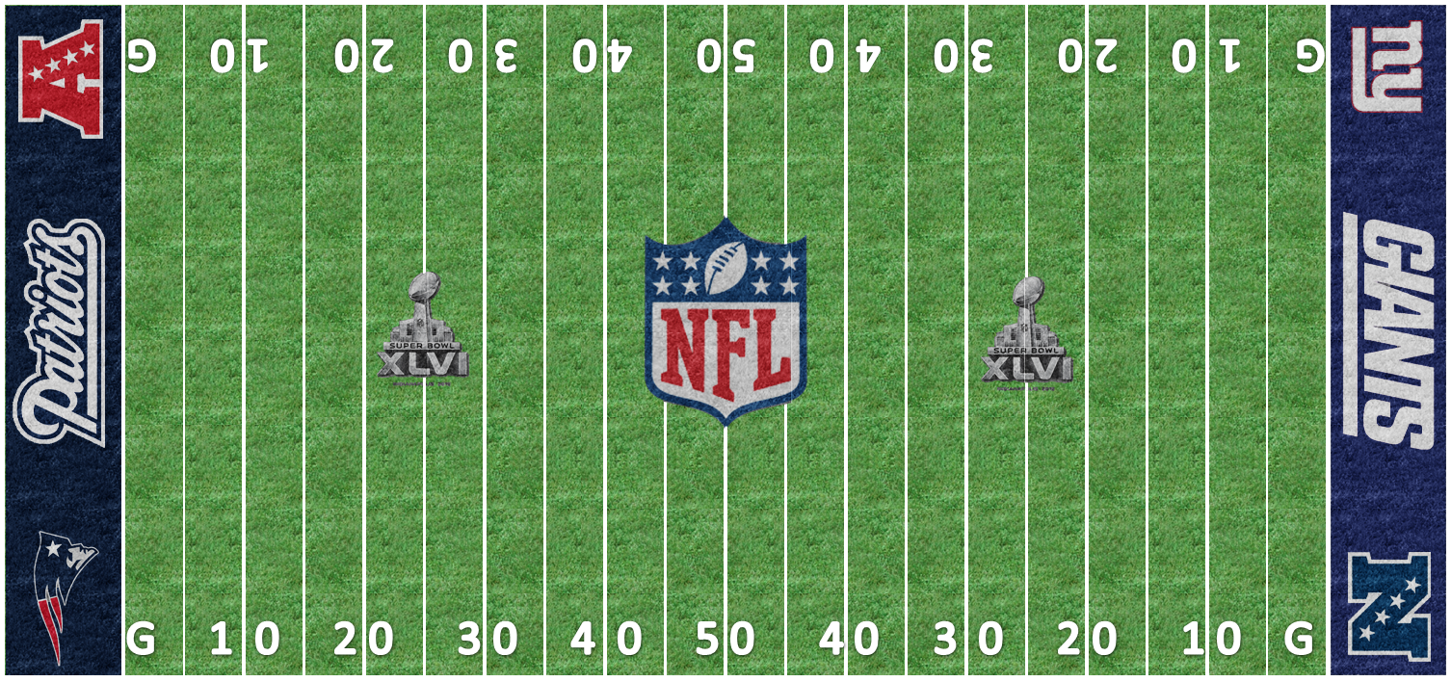
Formal definition:
“Given any combination of down, yards to go, and distance from the end zone, the expected value of the points from that position are equal to the average of every next score from that position.” - Causey
Function of at least 3 play characteristics: down, distance, yard line.

Slide 7
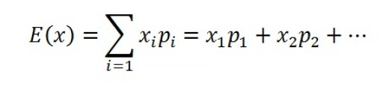
Some probability:
Expectation of random variable X
E(X) = 7(0.4) + 3(0.2) – 3(0.2) – 7(0.2) = 1.4
x | 7 | 3 | -2 | -3 | -7
p | 0.4 | 0.2 | <0.01 | 0.2 | 0.2

Slide 8
Expected value calculations
Point totals fixed – stated in terms of offense
-7, -3, -2, 0, 2, 3, 7
Probabilities are the probability that each point total is the next one scored
Conditional on down, distance, yard line
Ex: First and 10 from own 20-yard line

Slide 9
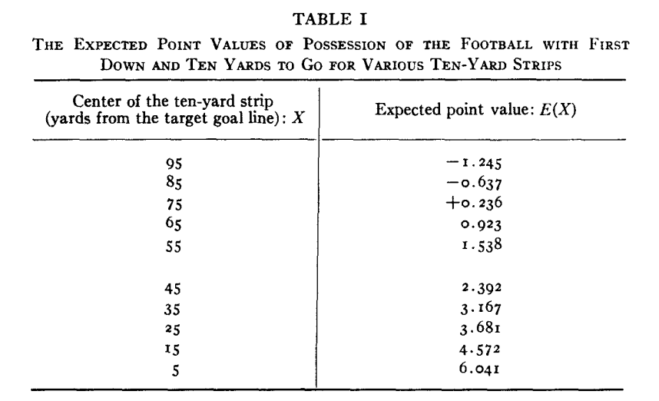
Expected value estimates
-Carter/Machol, 1971

Slide 10
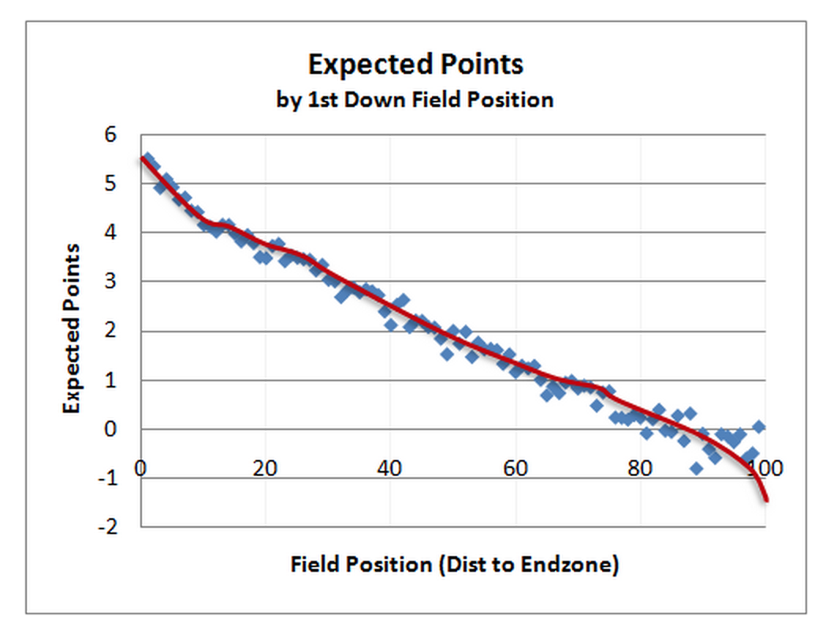
Expected value estimates
-Burke, 2010

Slide 11
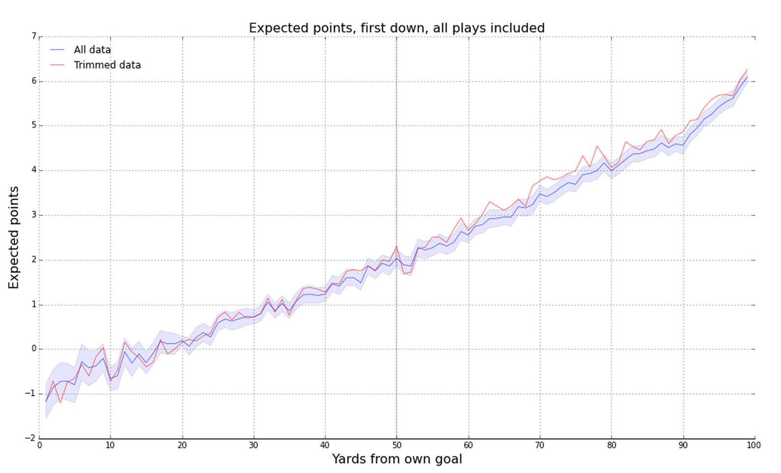
Expected value estimates
-Trey Causey, 2015

Slide 12
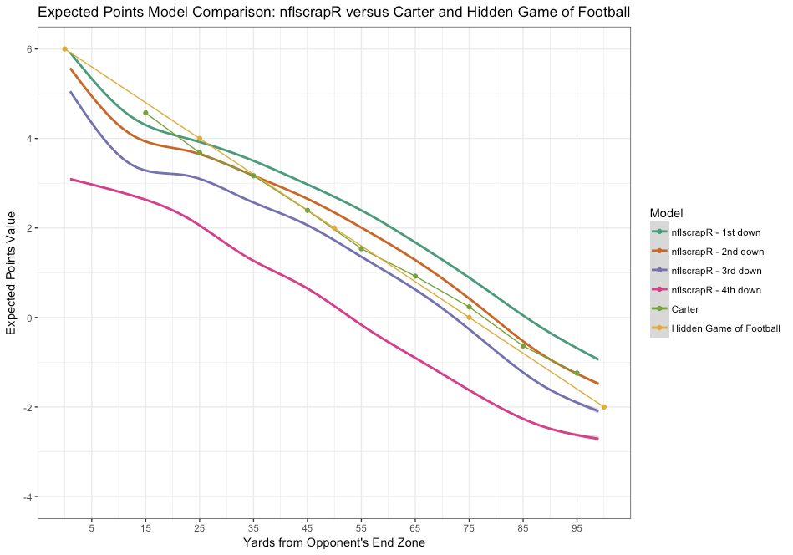
Expected value estimates
-Yurko et al, 2019

Slide 13
Expected points and NFL decisions
Example:
4th - 2 from opponents 23-yard, E(X) = 2.1
How to calculate probabilities?
1:
2:
How to improve calculations?
1:
2:

Slide 14
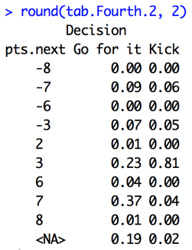
Expected points and NFL decisions
4th - 2 from opponents 23-yard line
Go for it:
E(X) = 2.81
Kick it:
E(X) = 2.14
What do coaches do?

Slide 15
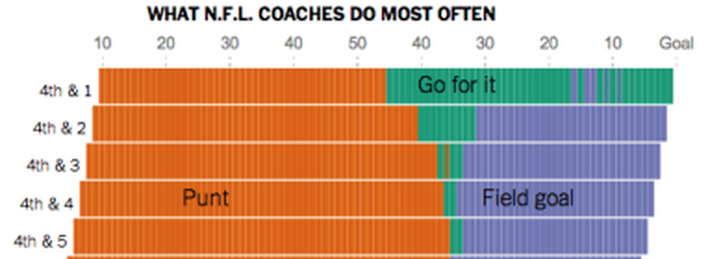
Expected points and NFL decisions
Fourth and 2, opponents 23 yard line
Going for it ~ 2.8 expected points
Field goal ~ 2.1 expected points
In reality, coaches kick field goal roughly twice as often in this example

Slide 16
Expected points and NFL decisions
Details
Quarters 1/3 & closer games receive priority
Extensions: Expected points added
- Ex 1: Kicker value
- Ex 2: Play value
- Ex 3: Play choice
- Win probability models
Weaknesses: Not all points created equally

Slide 17
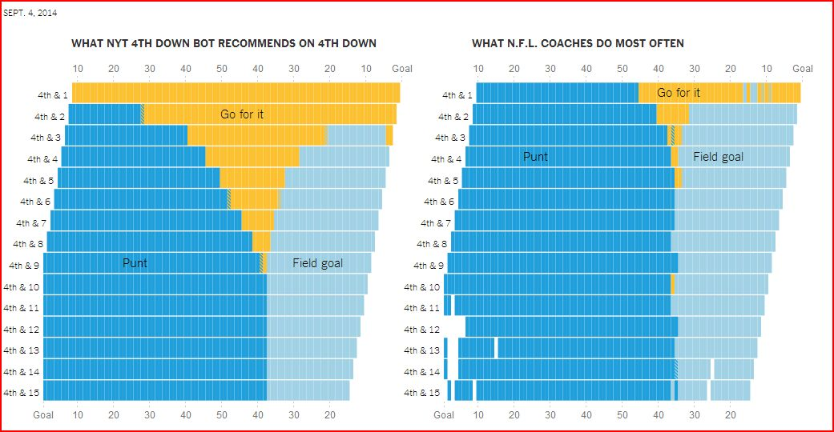
NFL Decisions

Slide 18
NFL Decisions
Reasons for varying strategy
Minimax
Prospect theory
Risk aversion

Slide 19
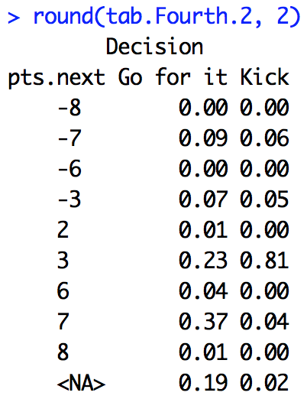
NFL Decisions: Minimax
Minimax: decision that minimizes possible loss in worst case scenario
Ex: 4th and 2 from opponents 23

Slide 20
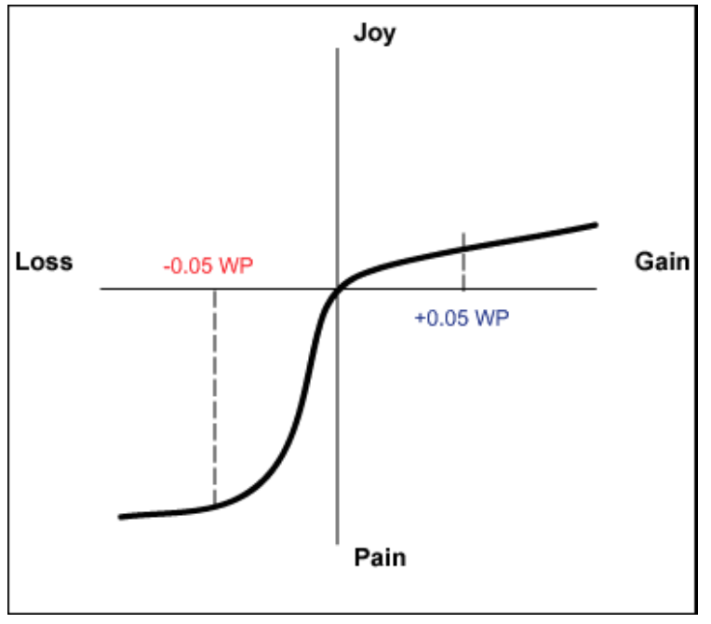
NFL Decisions: Prospect Theory
Prospect theory: humans make decisions based on value of losses and gains, and not on final outcome – and fear of losses outweighs equivalent gains.
Ex: Run versus pass

Slide 21
NFL Decisions: Risk aversion
Risk adverse: reluctance to accept bargain in favor of decision with more certain – but possibly lower - payoff
"Had we done that [gone for it] after what we had done to get down there and [not scored a touchdown], I can imagine what the critique would have been today about the play call.” – Brian Billick
“You guys might very well be right that we’re calling something too conservative in that situation. But what you guys don’t understand is that if I make a call that’s viewed to be controversial by the fans and the owner, and I fall, I lose my job” – Marvin Lewis
What was Mike Smith thinking
Ex: 4th and 2 from opponents 23

Slide 22
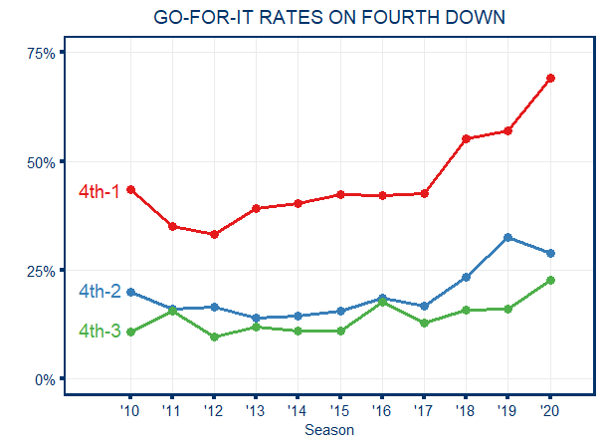
NFL Decisions:
https://twitter.com/StatsbyLopez/status/1179426045432344576/photo/1

Slide 23
Decisions in other sports
Minimax
Prospect theory
Risk aversion

Slide 24
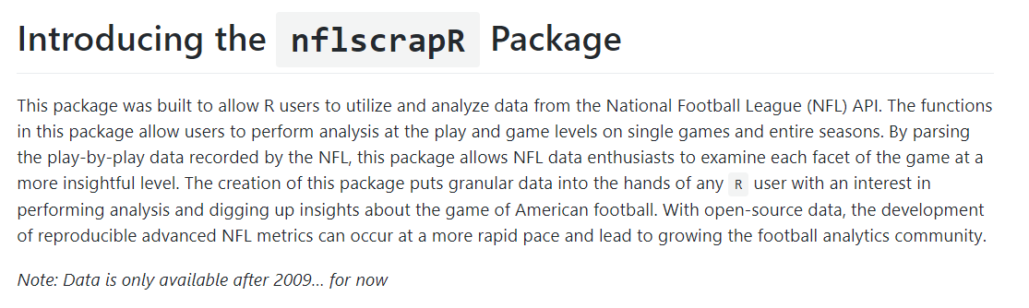
nflscrapR/nflfastR

Slide 25
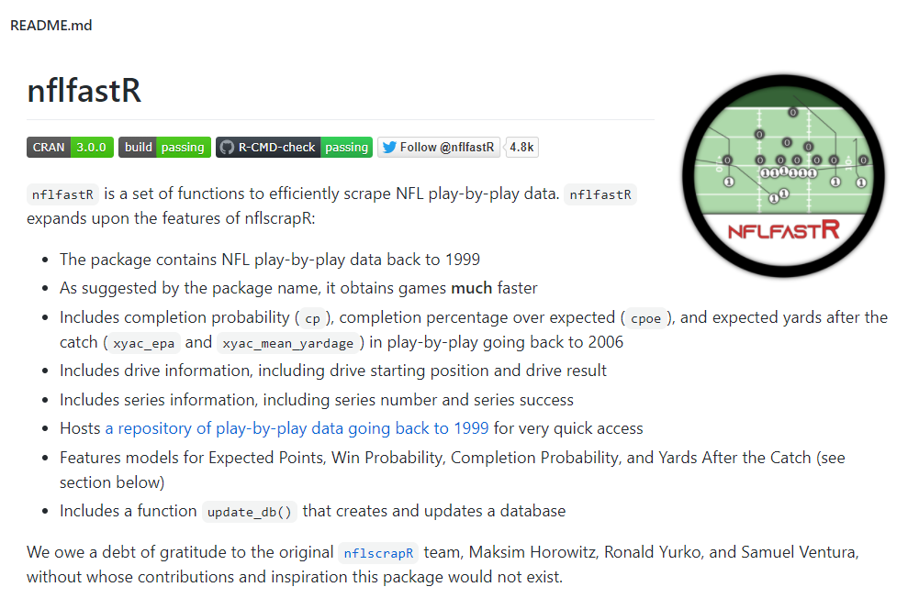
nflscrapR/nflfastR

Slide 26
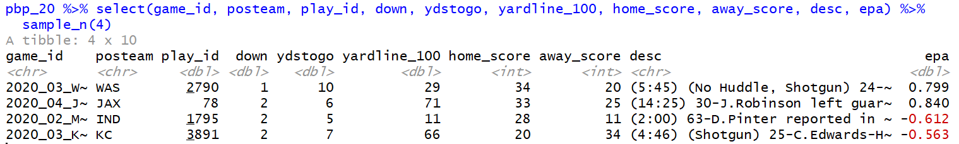
nflfastR

